Slide 1

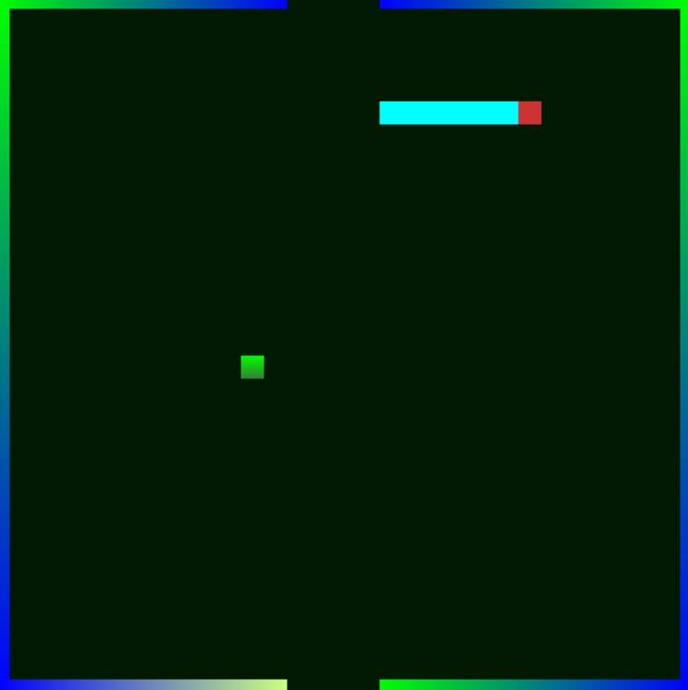


Snake Game Using Opengl
CSCI 452
Supervised by Dr. Nashwa

Slide 2
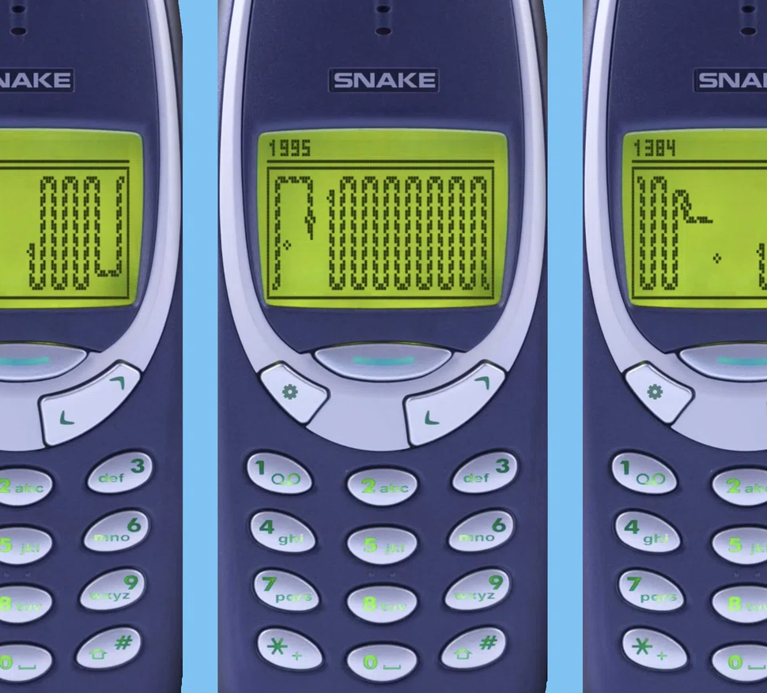
Agenda
Introduction
Methodology
Results

Slide 3
Introduction
Snake game is the game that we all used to play while we were young with the old Nokia phone. Snake is the reference to the predator which search for his prey all over his land to hunt it and eat it. For example, you can keep crawling all over the map or the land to try to eat your prey without biting yourself accidently and die, you might also crash to a collider or a wall. They are also a reference to getting out of your safe zone where you can become an easy target for the other predators.

Slide 4
“Sooner or later all things are numbers, yes?”
Terry Pratchett

Slide 5

New Prey Function

Slide 6
In New Prey function we used a random function within the map boundary to make sure the prey respawn after it’s eaten by the snake in a specific boundaries.

Slide 7
Erase Function

Slide 8
In the Erase Function We paint the color of the map again in Quads, so it appears like the snake tail is following its head.

Slide 9
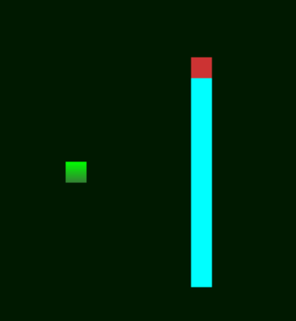
Redraw Function

Slide 10
In this function we paint again the snake body in Quads. To make the snake feels like it’s moving in the head direction to make sure the body keeps following the head.

Slide 11
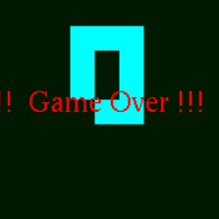
Check Strangled Function

Slide 12
In Check strangled function we check if the snake crashed into any of his body parts including the tail and if it happens then the game is over

Slide 13

Display Text Function

Slide 14
This function Displays any text written after the game is ended or if the snake died. And it shows whether the game is over by losing or a congratulation text if you won

Slide 15
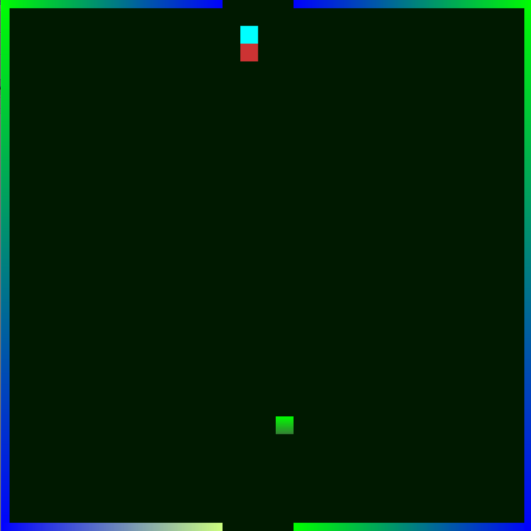
Boundary Function

Slide 16
In boundary function we change the visual appearance of the map or the land boundaries starting from the color to the shape of the map walls.

Slide 17
My keyboard Function

Slide 18
In my keyboard function, we make the snake moves by the keyboard arrow keys. With each arrow with the known direction.

Slide 19


THANK YOU
18102358
18101740
Abdelrahman Mohamed
BahaaEldin Maher

